Slide 1

2016-23rd IFHTSE Conference
Hot Hydroforging of Lightweight Bimaterial Gears and Hollow Products
Bulent Chavdar¹, Robert Goldstein², Lynn Ferguson³
¹Eaton, Southfield, MI, USA
²Fluxtrol Inc., Auburn Hills, MI, USA
³DANTE Solutions Inc., Cleveland, OH, USA
April 20, 2016

Slide 2
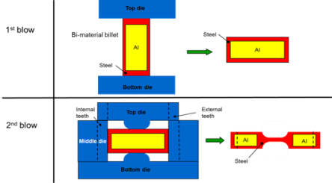
What is Hot hydroforging?
Definition: Hot forging of lightweight products from a hybrid billet of a metal shell and a low melting core.
Viscous core
Concept: Hot hydroforging is done at temperatures where the core material is in viscous state and builds up uniform pressure thereby enabling a uniform deformation of the metal shell.
Core is squeezed
out of center.
Goal: Lightweight net shape forging with complex topologies

Slide 3
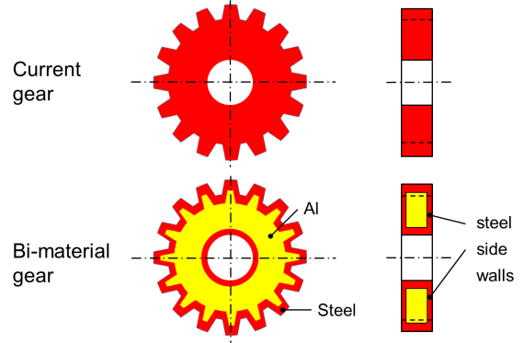
Hybrid lightweight gear
The outer structure is steel, the inner structure is a low melting lightweight material.

Slide 4
Objectives
Forging light weight hybrid gears with net teeth and near net center.
The hybrid gear has all steel outer structure.
Investment forging is enabled (molten core can be emptied).
Press loads are reduced and larger gears can be forged.
30% to 50% weight reduction per gear is targeted.
60% to 70% reduction in machining scrap rate due to near net teeth.

Slide 5
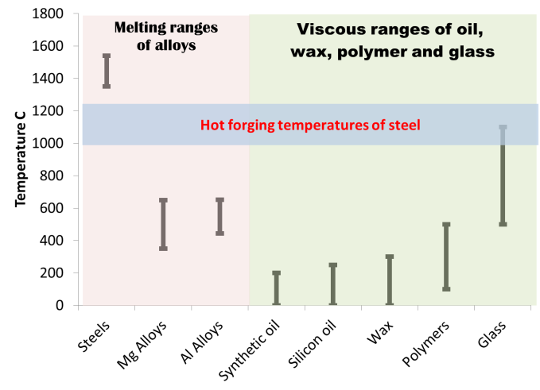
Steels and low melting point materials

Slide 6
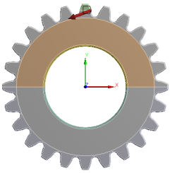
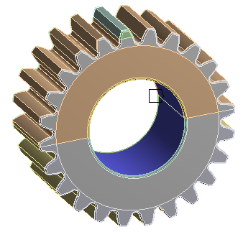
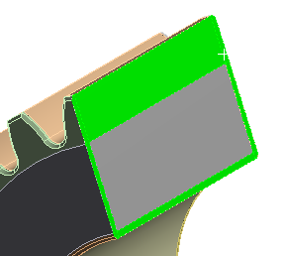
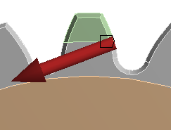

FEA modeling of stand-alone hybrid gear
Loads, BCs and Contacts
Cylindrical support
Gear Loads
Bonded contact between Inner Al and Outer Steel.
Ft (N) | Fr (N) | Resultant (N)
-22638 | -8500 | 24181

Slide 7


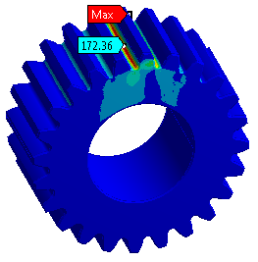
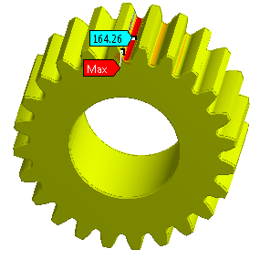

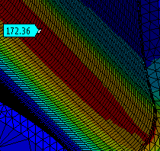
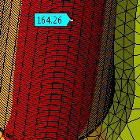
Stress plots
Max von-Mises stress at fillet = 172.4 MPa
Max Principal stress at fillet = 164.5 MPa

Slide 8
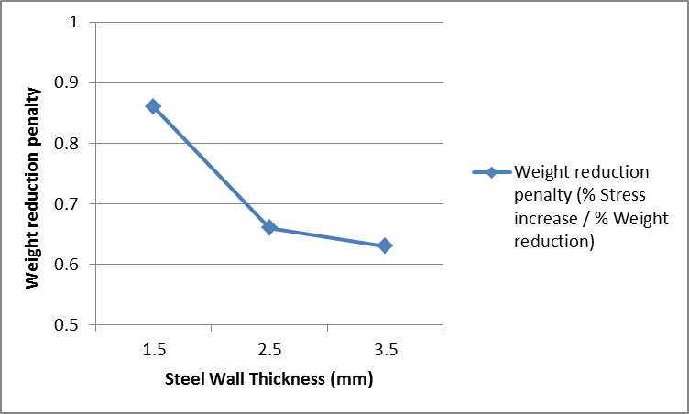
Wall thickness optimization-Steel/Al gear
Trade off between weight reduction and stress increase
Steel wall Thickness (mm) | Weight reduction (%) | von-Mises stress (MPa) | Stress Increase (%) | Weight reduc. penalty
All steel |  | 128
1.5 | 40 | 172 | 34 | 0.85
2.5 | 35 | 158 | 23 | 0.66
3.5 | 30 | 152 | 19 | 0.63
Optimum steel
wall thickness

Slide 9

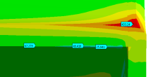
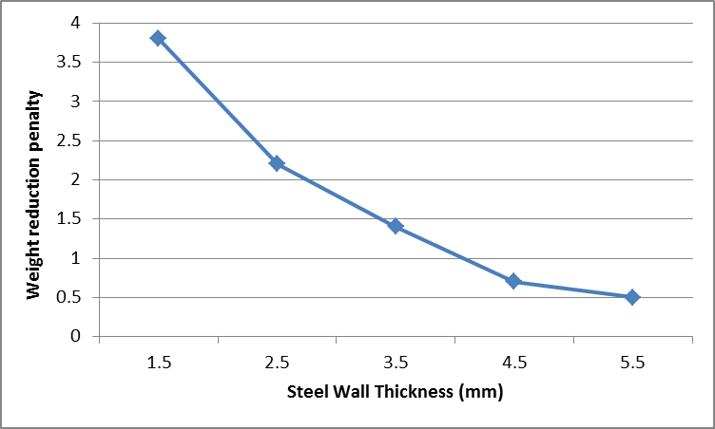

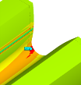
Wall thickness optimization-Hollow gear
Trade off between weight reduction and stress increase
Hollow gear
Steel wall Thickness (mm) | Weight reduction (%) | von-Mises stress (MPa) | Stress Increase (%) | Weight reduc. penalty
All steel |  | 128
1.5 | 61 | 433 | 238 | 3.9
2.5 | 53 | 280 | 119 | 2.2
3.5 | 46 | 211 | 65 | 1.4
4.5 | 40 | 162 | 27 | 0.7
5.5 | 35 | 150 | 17 | 0.5
1.5 mm wall
2.5 mm wall

Slide 10
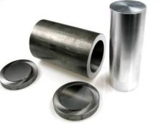
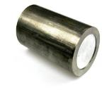
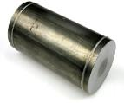
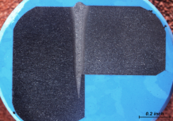
Hybrid billet design for hot hydroforging
Steel tube
seamless, and w/ seam
0.25” and 0.5” wall
Al bar
Interference fit
0.003”, and 0.005”
Weld bead
Electron beam welding
Factors Levels
Wall thickness 0.25” (6.25 mm) 0.5” (12.5 mm)
Steel tube type seamless with seam
Interference fit 0.003”(0.075mm) 0.005” (0.125 mm)
Forging technique Hot (solid state) Hot hydroforging
Tube
Cap

Slide 11
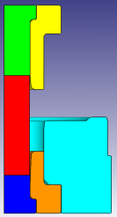
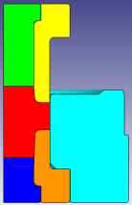
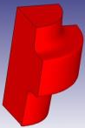
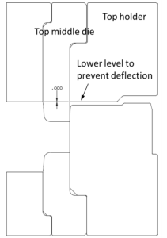
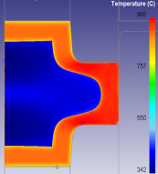
Die design and simulations
Before forging
After forging
Forged part
Weld bead
Electron beam welding
The pockets in the top and the bottom dies keep the weld zone of end caps under compression during busting forging.
Closed and split die

Slide 12
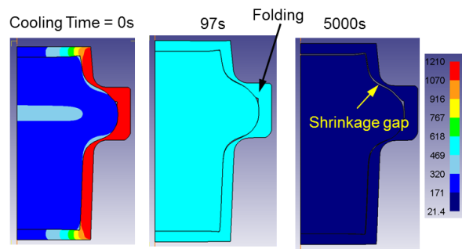
Solid state hot forging simulations
Solid state forging simulations predicted folds, shrinkage gap and non-uniform steel wall thickness.

Slide 13
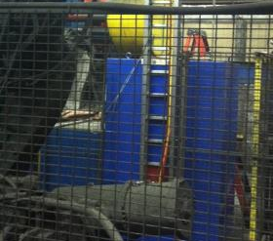
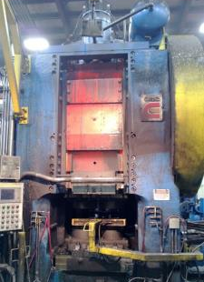
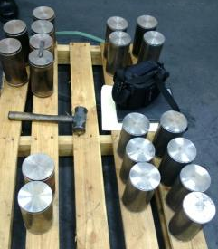
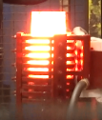
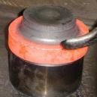
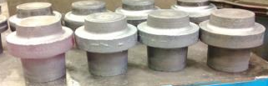
Forging trials
10 kHz Induction heater
Bi-Metal billets before forging
Erie 4000 ton mechanical press
Heating
Transferred to the die
Right after forging
A few seconds after forging
Forged parts
Forged parts

Slide 14
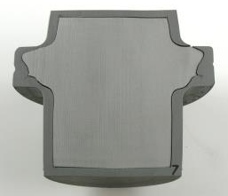
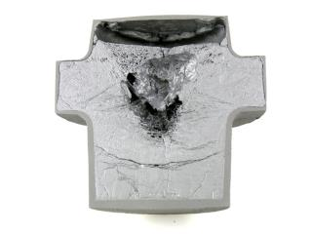
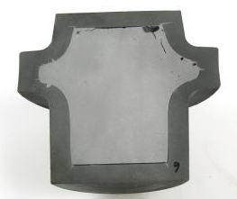
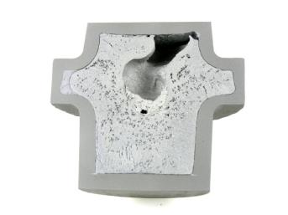
Comparison of hot forging and hot hydroforging experiments
Solid state hot forging
Steel @1100C
Al core @400C
Hot hydroforging
Steel @1100C
Al core @1100C
Fractured wall
Void due to CTE mismatch
Incomplete fill
Non-uniform wall
Fold
No fracture or crack
Gap due to CTE mismatch
Uniform wall
Cracks
Hot hydroforging is promising
if CTE mismatch is eliminated
Not successful
Successful

Slide 15
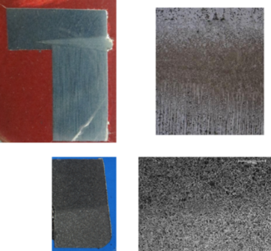
Weld zone healing in hot hydroforging
Before forging
Dendritic structure
After busting hot hydroforging
Normalized structure
Dendritic structure of weld zone disappeared after hot hydroforging

Slide 16
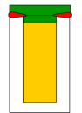


“Investment Forging”
Investment forging is a term coined at Eaton.
It describes a process where the molten core is evacuated from the forged part after a hot hydroforging process leaving behind a hollow part.
Investment forging provides the ultimate weight reduction up to 50% for a gear.
Investment forging can also be applied to many other forged parts. For example forged hollow engine exhaust valves can be created by investment forging.
eb weld
Core
emptied
Steel
Low melting
core

Slide 17
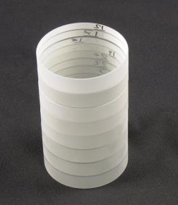
Eliminating CTE mismatch with glass
Glass is identified as the core material of choice with matching CTE to that of steel, 10-12 (10⁻⁶ m/mK).
The other advantages of glass:
  Low cost
  Low density
  Good bonding to steel
  Lower elastic modulus than steel
  Working temperature can be optimized
  May enable and temper a through-hardened steel wall

Slide 18
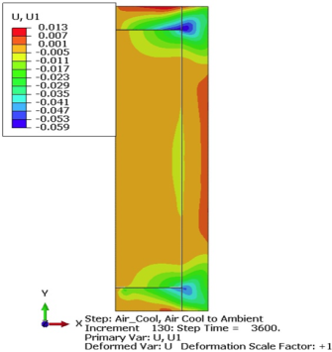
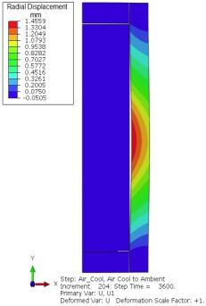
Induction heating / air cooling simulations
Displacement and gap formation in solid state
Steel/Glass
Steel/Aluminum
No gap predicted
Significant gap predicted
Glass is a promising lightweight core material.

Slide 19
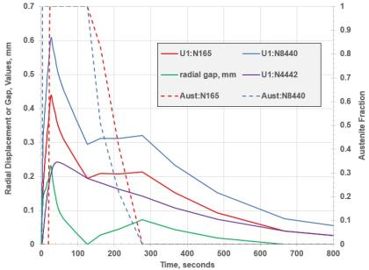
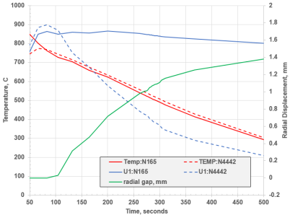
Induction heating / air cooling simulations
Histories of displacements and gap formation in solid state
Steel/Glass
Steel/Aluminum
Induction
heating
Induction
heating
Air cooling
Air cooling
*
*
No gap predicted
Significant gap predicted
*
N165 is on steel bore, and N4442 is on outer surface of core.

Slide 20
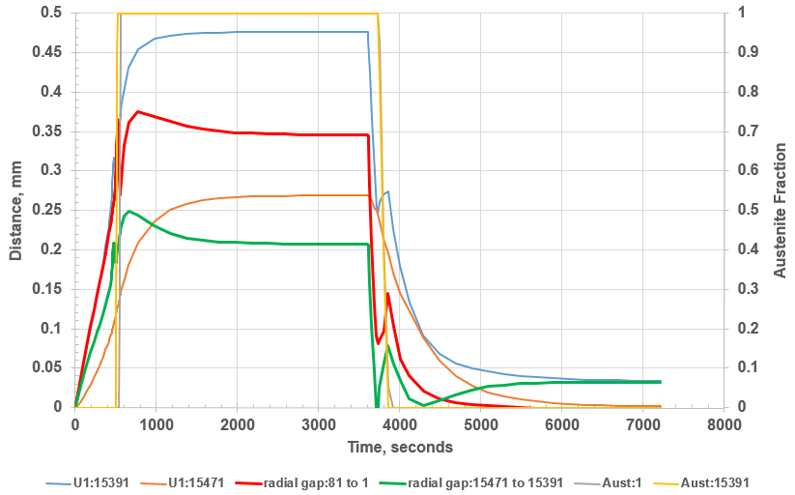
Furnace heating / air cooling simulations of steel/glass History of displacements and gap formation (no phase change)
Furnace heating
Air cooling
32 μm gap
in upper and
lower halves
No gap
at mid height
No gap predicted
Assumed no bonding between steel and glass.
In reality steel and glass will bond. There will be no gap.
Steel/glass billets can be heated in furnace without fracture.
Steel/aluminum cannot be heated in furnace without fracture.

Slide 21
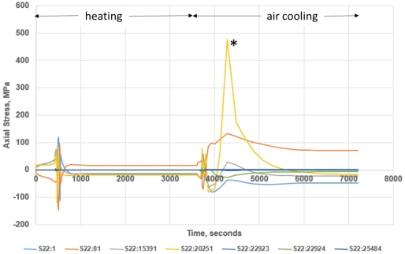
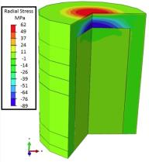
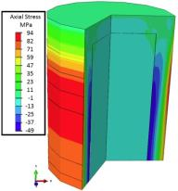
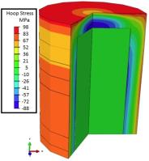
Stress histories and final stress states in steel/glass after furnace heating and air cooling
Axial stress histories on various locations on steel cylinder.
* The highest axial stress occurs at the inner corner of steel end cap and the steel cylinder
Final stress states
*

Slide 22
Conclusions
Feasibility of hot hydroforging and investment forging for lightweighting, net shape forging and waste reduction are demonstrated.
Steel/aluminum hybrid billets were prepared. Then, the billets were hot hydroforged in closed dies.
A uniform steel wall thickness was observed all around the hot hydroforged part upon cross sectioning.
Weld seams are healed (normalized) upon hot hydroforging.
Steel/glass is a more promising hybrid than steel/aluminum for hot hydroforging due to the CTE match.

Slide 23


Slide 24
Back up slides

Slide 25
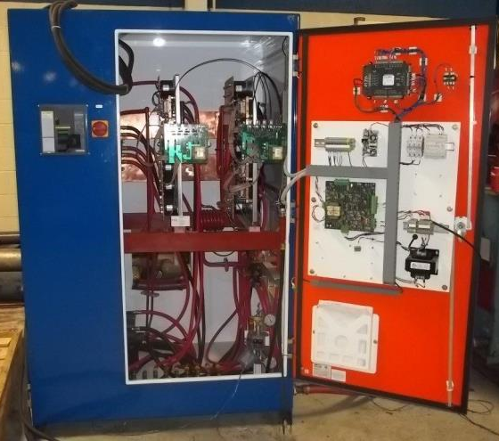
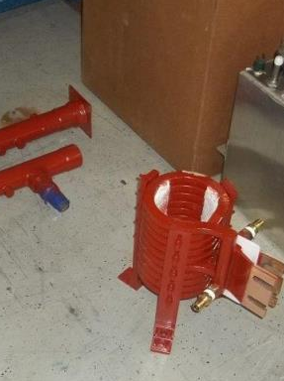
  High frequency induction power
  10 kHz, 500 kW
Coil for high frequency induction heating
Induction heater controller

Slide 26
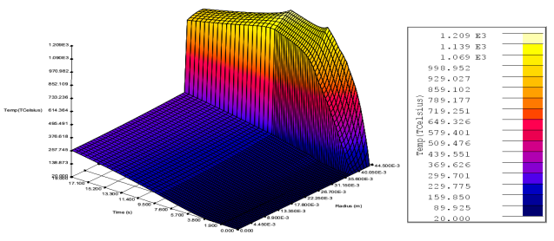




Induction heating simulations for solid state hot forging
Temperature vs. time in the radial direction
Steel Case
Transfer
Hold
Ramp
Al Core
Steel Case
Al Core
Both steel and aluminum are in solid state
Due to differential heating rate steel shell pulled away from the core

Slide 27


Billet induction heating simulations for hot hydroforging, on-off control strategy
Iso-temperature lines showing the temperature distribution in the radial direction from the center axis to the outer diameter of the billet at mid height of the billet as function of the heating time. The heating simulation shows the effect of on/off control strategy
Heating simulation shows that aluminum core reaches 1000C in 6 on/off cycles in 60 seconds

Slide 28


FEA of subassembly with hybrid gears
Steel on the outside
Gear D
Aluminum in the core
Gear B

Slide 29





Force reactions at bearing supports and torsional spring at end face
Torsional spring at end face
Bearing Rear
Bearing Front
Global deformation of assembly
reduces stress concentration

Slide 30
Subassembly deformation and stress
All steel gear and hybrid forged gear
Deformations
 | Hybrid-Bi-Metal forging |  |  | All Steel
 | Gear B | Gear D | Countershaft | Gear B | Gear D | Countershaft
Total (mm) | 0.48 | 0.425 | 0.297 | 0.46 | 0.421 | 0.294
Angular (⁰) | 0.31 | 0.31 | 0.31 | 0.3 | 0.3 | 0.3
Radial (mm) | -0.063 | -0.127 | -0.127 | -0.06 | -0.122 | -0.123
Axial (mm) | 0.081 | -0.0442 | 0.032 | 0.077 | -0.043 | 0.031
Stresses (MPa)
No stress or deflection is increased more than 8% for the bimetal gear compared to the all-steel gear
 | Hybrid-Bi-Metal forging |  | All Steel
 | Gear B | Gear D | Gear B | Gear D
Von-Mises | 825 | 876 | 761 | 745
Max principal | 730 | 729 | 696 | 674
Min principal | -934 | -978 | -859 | -831

Slide 31


Die stress analysis
Forging
temperature: 1100C
b
d
e
a
c
a
b
c
d
e
Ram displacement (mm/406mm) | Forge load (ton) | Fill radius, d (mm) | Stress at the die fillet, d (MPa)
405.90 | 973 | 1.50 | 2120
405.87 | 758 | 2.30 | 1750
405.68 | 552 | 4.25 | 1320

