Slide 1

Improved Sustainability of Induction Tube Welding Systems Using Soft Magnetic Composites
Sean Muyskens
Robert Goldstein
www.fluxtrol.com

Slide 2
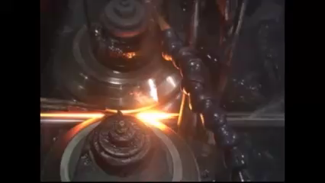
Overview
Induction tube welding industry
Opportunity to improve efficiency
Impeder benefits and material selection
Conclusions

Slide 3
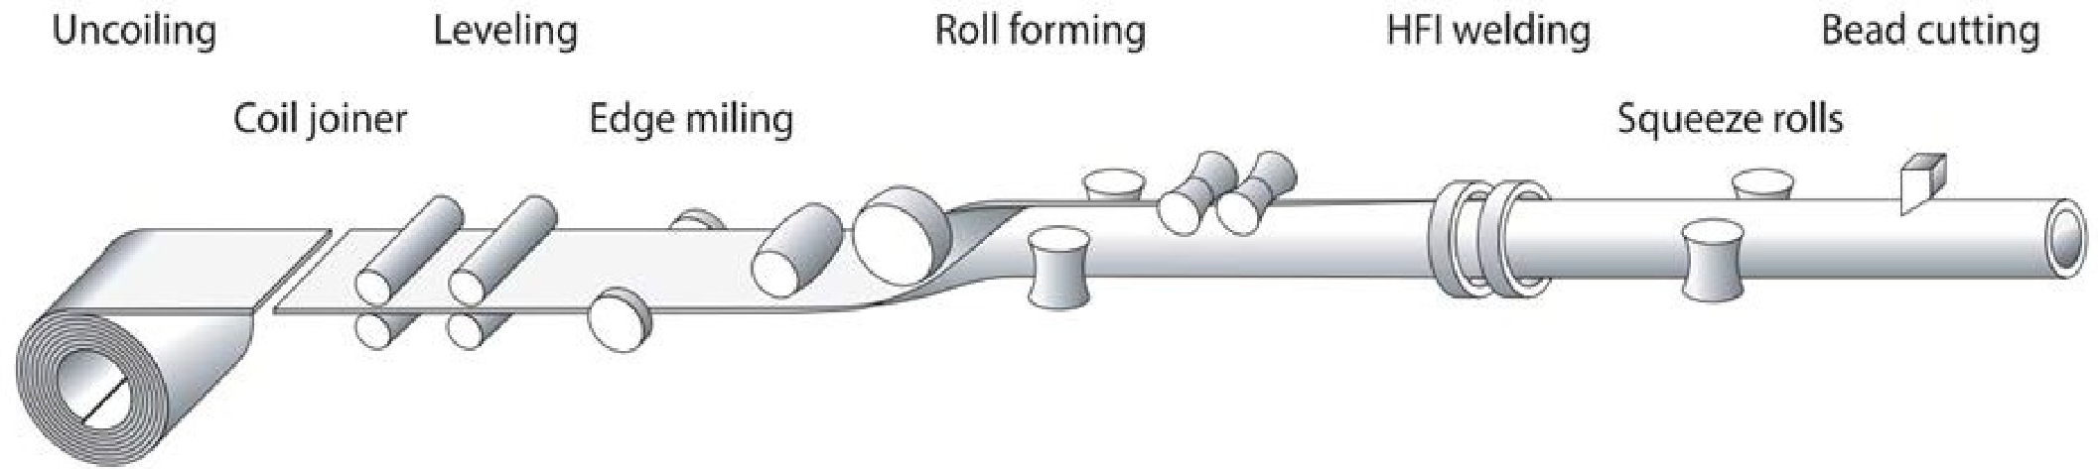
Induction Tube Welding Industry
Induction tube welding is a key technology for the fabrication of tube and pipe
Tube welding lines installations number over 1000 globally
There exists an opportunity to improve the energy efficiency of these lines and greatly reduce the ecological cost of producing the same amount of product
Egger, C., Lüchinger, M., Schreiner, M., Tillmann, W. Numerical Simulation of Tube Manufacturing Consisting of Roll Forming and High-Frequency Induction Welding. Materials 2022, 15, 1270.

Slide 4
Prinz & Co. GmbH Stahlrohre Case Study
Tests were done in Germany and funded by German Government
Case setup:
~400kHz 50-150kW power supply
15mm OD steel tube
1.2mm thick wall
8.5-9mm OD impeders
Energy savings for the same line speed was ~40%
Energy savings are 25kW or the equivalent of preventing 80 metric tons of CO² per year and saving €12,500
>20 hours impeder life with little to no sign of wear, compared to 4 hours typical for the ferrites
 | Line Speed (m/min) | Power (kW)
9mm Ferrite | 77 | 58
8.5mm Fluxtrol 50 | 77 | 33
https://www.eea.europa.eu/en/analysis/maps-and-charts/co2-emission-intensity-15
Assuming €0.10/kWh

Slide 5
Other Cost Benefit Analysis - 5000 hrs/yr
Material | Core Cost | Impeder Cost | Impeder Life | Changeovers/yr | Total Impeder Cost
Ferrite | €5 | €50 | 4 hrs | 1250 | €62,500
SMC | €170 | €215 | 20 hrs | 250 | €53,750
Material | Line Cost | Changeover time | Impeder Life | Changeovers/yr | Changeover Time Cost
Ferrite | €10/min | 30 minutes | 4 hrs | 1250 | €375,000
SMC | €10/min | 30 minutes | 20 hrs | 250 | €75,000
Material | Scrap Cost | Restart Time | kg Scrap/ Changeover | Impeder Life | Changeovers/yr | Changeover Scrap Cost
Ferrite | €4.5/kg | 1 minute | 31 | 4 hrs | 1250 | €174,375
SMC | €4.5/kg | 1 minute | 31 | 20 hrs | 250 | €34,875
Total annual savings are ~€450,000, or €90/hr
Lowers line cost by 15%
€10 a minute number based upon assumption you can sell tube for €0.3/kg more than sheet steel

Slide 6
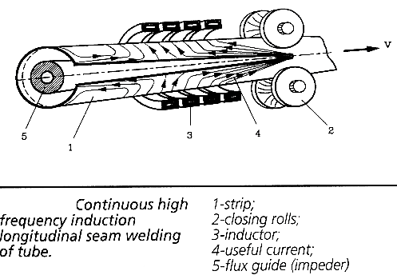
Induction Tube Welding Process
Current is induced in the tube body
When the currents hit the open seam, there are 3 options for current flow
Towards the welding point
Back along the seam edges
Along the ID of the tube
Lupi, S. UIE 1992 “Induction Heating – Industrial Applications”

Slide 7
Inductive Tube Welding Market Trends
The availability of higher, more efficient power at choice of frequencies
Improved material handling
More Advanced Process Monitoring and Control – Industry 4.0
Improved Material Cutting
Limiting factor in the performance of many small tube installations is now the impeder

Slide 8
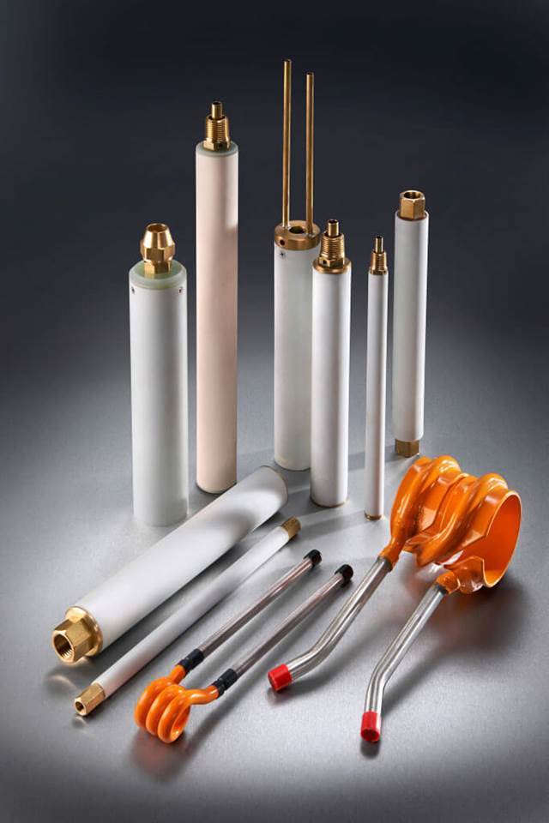
What is an impeder?
An assembly that contains a soft magnetic material that “impedes” the current flow on the inside of the pipe
Typically manufactured using ferrite materials
Fixtured within the forming tube
ENRX I Consumables for Tube and Pipe Welding

Slide 9
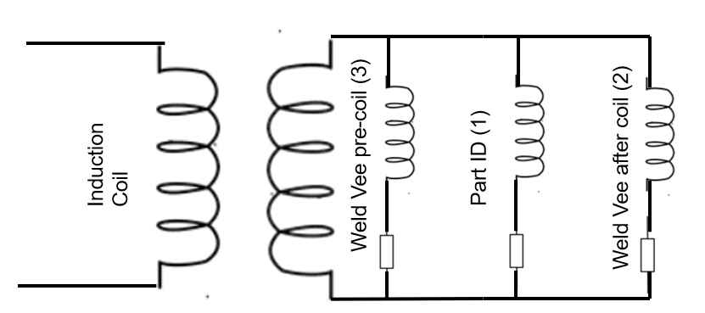
Circuit Model Concept
The product of magnetic permeability of the core and the cross-sectional area of the core are ≈ directly proportional to inductance for the part ID path
The higher the value of the product
The greater the inductance of the Part ID current path
The lower the percentage of current that will flow on the part ID
The larger percentage of the current on the tube edge

Slide 10
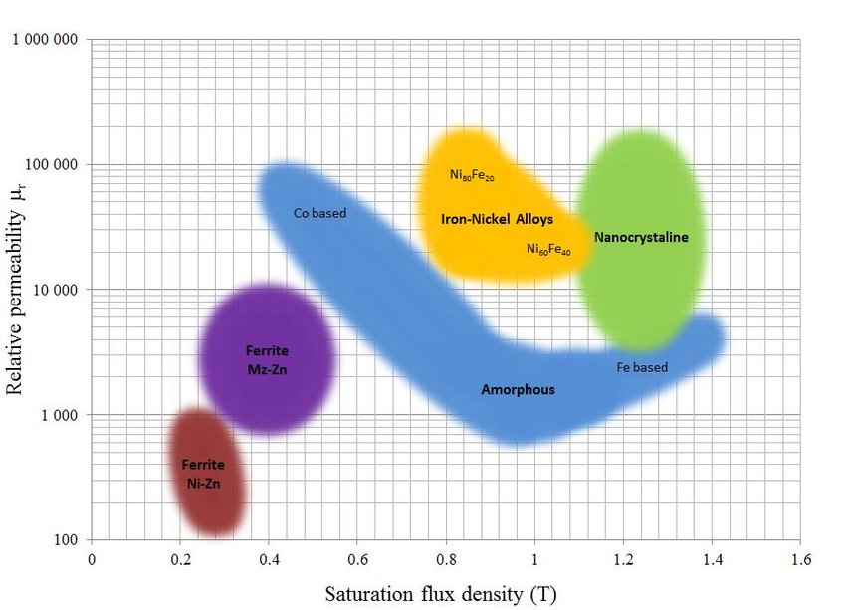
Magnetic Properties of Soft Magnetic Materials Used as Magnetic Cores
Soft Magnetic Composites
M. Kącki, M. S. Rylko, J. G. Hayes and C. R. Sullivan, "Magnetic material selection for EMI filters," 2017 IEEE Energy Conversion Congress and Exposition (ECCE), Cincinnati, OH, USA, 2017, pp. 2350-2356, doi: 10.1109/ECCE.2017.8096456.

Slide 11
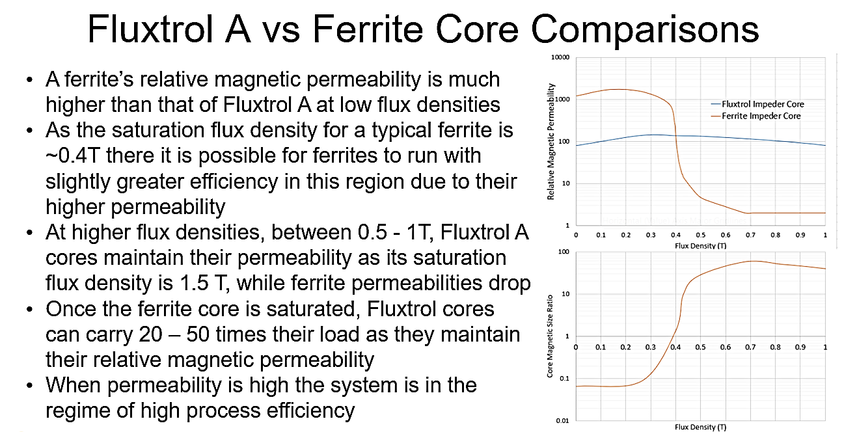
Fluxtrol A vs Ferrite Core Comparison
Below their saturation flux density, typical ferrites used for impeders will outperform the Fluxtrol A material
Above their saturation flux density, Fluxtrol A will outperform ferrites
At the level of 0.7 Tesla and above, Ferrite will only be approximately 2 X better than air, while Fluxtrol A remains approximately 100 X better

Slide 12
SMC vs Ferrite Impeders
Advantages of SMC
Disadvantages of SMC
Higher Saturation Flux Density
Performance Improvement
Temperature/time stability of magnetic properties
Improved stability of production (ferrite properties very sensitive to temperature and stresses)
Cost of impeder
Lower permeability at low fields
Higher losses than ferrites
Requires better cooling
May not work in gas cooled systems

Slide 13
Opportunities for SMC Impeders
Small diameter, heavy-walled steel tubes
Small tube applications where welder is the bottleneck and impeder is in saturation
Applications where impeders frequently fail due to mechanical impact with line
Applications with metallic components inside of the impeder
Applications with very short impeder life

Slide 14
Barriers to Adoption
Tests on a tube mill are very expensive
50 to 300 m/min line speeds typical
Validation of new process can be very expensive
Ferrites are proven technology and the current industry standard for decades
SMC cores are 10 – 50 times more expensive to purchase on an individual unit basis
Annual Costs of Impeders Only are often similar, production savings tend to be much higher
SMC losses are higher, so good cooling is required
Need to be mindful of water circuit design

Slide 15
Broader Impact
Various case studies have shown 20-50% energy savings in small tube welding lines to produce at the same rates
Given widespread adoption of more energy efficient SMC impeder cores, the opportunity in carbon reduction is on the order of tens of megatons of CO² per year without initial capital investment required
Additionally, the potential for longer lasting impeders and fewer changeovers increase line uptime and reduce scrap

Slide 16
Conclusions
Many small tube welding installations are limited by the impeder
SMC’s have the potential to greatly improve the performance of these installations
20 – 50% energy savings/carbon reduction
Increased impeder and coil lifetime
Production rate improvements
Savings are €100’s of thousands annually per line
SMC’s have higher magnetic losses, so it important to appropriately design the impeder core and cooling circuit

Slide 17
For more information on SMCs and Induction Tube Welding
Visit: www.fluxtrol.com
Sean Muyskens
Robert Goldstein

